Slide 1
The Economics of Privacy
Alessandro Acquisti
Heinz School, CMU
acquisti @ andrew.cmu.edu
Draft

Slide 2
It’s the economy, stupid!
James Carville, Bill Clinton’s political strategist in the 1992 election
Privacy is an economic problem…
… even when privacy issues may not have direct economic interpretation
Privacy is about trade-offs: pros/cons of revealing/accessing personal information
  Individuals
  Organizations
… and trade-offs are the realm of economics
Notes:
James Carville, Bill Clinton’s political strategist in the 1992 election

Slide 3
Agenda
Why privacy is important for the economy and interesting for economists
The evolution of the economics of privacy
Current issues and open questions

Slide 4
Why privacy is important for the economy and interesting for economists

Slide 5
Privacy and the Economy
“I am under no moral or other Obligation, to publish to the World, how much my Expences and my Incomes amount to yearly. […] Dissimulation is a branch of Wisdom.”
John Adams, 1761
American census, 1799
Warren and Brandeis, 1890
“Franklin Mills Flour” girl, 1901 (Ellis Smith [2000])
SSNs, 1935
Retail Credit Co., TRW
Equifax, Experian
Amazon, Real Audio, eToys, 2000s

Slide 6
Personal Information as an Economic Good
Asymmetric information
  Individual does not know how, how often, for how long her information will be used
  Intrusions invisible and ubiquitous
  Externalities and moral hazard
Ex-post
  Value uncertainty
  Keeps on affecting individual after transaction
  Imagine: lump sum vs. negative annuity

Slide 7
Personal Information as an Economic Good
Context-dependent (states of the world)
  Anonymity sets
  Recombinant growth
  Sweeney (CMU): 87% of Americans uniquely identifiable from ZIP code, birth date, and sex
Subjective
  “Willingness to pay” affected by considerations beyond traditional market reasoning

Slide 8
Personal Information as an Economic Good
Private and public good aspects
  As information, it is non rival and non excludable
  The more other parties use that personal information, the higher the risks for original data owner
Buy vs. sell
  Individuals value differently protection and sale of same piece of information
    Like insurance, but:

Slide 9
The Two Markets of Privacy
Privacy issues actually originate from two different markets
  Market for personal information
  Market for privacy
Related, but not identical
Confusion leads to inconsistencies
  Different rules, attitudes, considerations
    Public vs. private
    Selling vs. buying
    Specific vs. generic
    Value for other people vs. damage to oneself
    Lump sum vs. negative annuity

Slide 10
Market for personal information
Companies that deal with customers data, infomediaries, credit bureaus
Companies that want to know more about consumers
Consumers who willingly or unknowingly reveal personal information
  Value of email addresses: ~few dollars for 100,000/1,000,000s
  Cost to access your credit history for you: ~29/39$
  Cost to access your credit history for other companies: much less!

Slide 11
Market for privacy
Companies that offer privacy enhancing technologies
Companies that promise to keep their customers information protected and private
Consumers who adopt privacy enhancing technologies and/or strategies
  Cost of “Freedom Network” technology: ~40 $
  Users: some thousands, but not enough to cover fixed costs
  Anonymizer: mixed model

Slide 12
What is Privacy, anyway?
Freedom to develop (Scoglio 1994)
Aspect of human dignity (Bloustein 1964)
Right to be left alone (Warren and Brandeis 1890)
Ability to control own space (Sweeney 2002)
Tort (Prosser 1960)
  Disclosure of intimate facts
  False light
  Misappropriation
  Intrusion into somebody’s solitude
Ability to control access to one’s information (in/out) (Noam 1996, Samarajiva 1998 – among many others)

Slide 13
Definitions and Economics
Posner 1980
  Privacy as concealment of information
  Privacy as quiet
  Privacy as freedom

Slide 14
Definitions and Economics
Posner 1980
  Privacy as concealment of information – focus
  Privacy as quiet
  Privacy as freedom

Slide 15
Definitions and Economics
Posner 1980
  Privacy as concealment of information
  Privacy as quiet – little economic relevance
  Privacy as freedom

Slide 16
Definitions and Economics
Posner 1980
  Privacy as concealment of information
  Privacy as quiet
  Privacy as freedom – no economic relevance

Slide 17
Definitions and Economics
Now:
  Privacy as concealment of information
  Privacy as quiet
  Privacy as freedom
    Even when privacy intrusions have no immediate economic relevance, immaterial dimensions of privacy still impact the well-being of the individual
    Economics of happiness and well-being studies

Slide 18
The evolution of the economics of privacy

Slide 19
Snapshot
Early 1980s
  Chicago school vs. broader views of privacy
Mid 1990s
  IT explosion: Varian, Noam, Laudon, Clarke
After 2001
  The Internet: personalization and dynamic behavior
  Modeling: price discrimination, information and competition, costs of accessing customers
  Empirical: surveys and experiments
  Economics and Law
  Economics of (Personal) Information Security
Related areas
  Marketing
  Economics: dynamic price discrimination

Slide 20
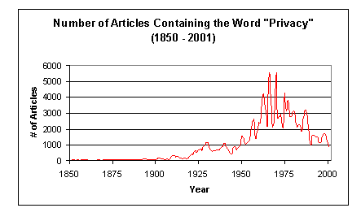
Snapshot
Chitra Kalyanaraman, CMU

Slide 21
The early days: Stigler
Peculiar relation between “ownership” and privacy
  Information about somebody may have been costly acquired by other people
Free exchange of information will lead to desirable results regardless of ownership
  If I am a good debtor, I want this information to be known; if I am a bad debtor, I want to keep it secret
  Suppose I am a bad debtor: then, whether I do not reveal information or information about me is reported, I will pay higher rates

Slide 22
The early days: Posner
Privacy as concealment of information
  Individuals with bad traits (e.g., poor employees) have interest in hiding them
  Individuals with good traits have interest in showing them
  Reducing information available to “buyers” in this market (employers) reduces efficiency
Extends argument to non-market behavior
  E.g., marriage
Costs of concealment borne by others
  E.g., when privacy of sex-offenders is protected
Privacy is re-distributive and reduces efficiency

Slide 23
The mid 1990s: Noam
If no transaction costs in trading or negotiation, initial assignment of privacy rights is arbitrary from viewpoint of economic efficiency
  Encryption
    “The existence of encryption may largely determine who has to pay whom, not whether something will happen”
    Encryption makes other parties pay
    Redistributes wealth to consumers
Difficulties
  Incomplete information
  Human right
  Burden on poor

Slide 24
The mid 1990s: Varian
Consumers rationally want certain kinds of information to be available to producers, not other kinds
  E.g., consumer wants seller to know what goods she likes, but not how much she likes them
Annoyances comes from too little information
  E.g., tele-marketers offering products I do not want
Externalities connected to secondary use of information
Define property rights in private information in ways that allow consumers to retain control over how information about them is used
  E.g., timed contracts
  E.g., make it costly to access certain digital information

Slide 25
A new economics of privacy
Calzolari and Pavan 2001
Acquisti and Varian 2001
Taylor 2001
Taylor 2003
Il-Harn et al 2004
…

Slide 26
Optimal privacy policies
Calzolari and Pavan 2001
Contracting environments where two “principals” (e.g., sellers) sequentially interact with a common “agent” (e.g., buyer)
  First seller releases information that is correlated with agent’s type
Welfare effects of privacy-protecting laws that prevent information disclosure on consumers’ shopping activity
  Information transmission between two vendors may result in welfare increase
  Reduces (expected) distortions

Slide 27
Inducing customers to try new goods
Acquisti and Varian 2001
Cookies-like technology vs. anonymizing technology
Questions
  Will cookies-like technology bring more profits?
  Will buyers use the anonymizing technology?
Results
  No larger profits from cookies-like technology…
  … unless something more is offered
  Enhanced services based on gathered information
  Anonymizing technologies could make society worse off

Slide 28
Customer privacy
Taylor 2001
Value of customer information derives from ability of firms to identify individual consumers and charge them personalized prices
Considers two settings: anonymity regime and recognition regime
Welfare comparisons depend critically on whether consumers anticipate sale of the list
  If consumers do not foresee sale of their data, firms have incentives to charge higher prices
  If consumers anticipate sale of list, this results in lower prices than would prevail under the anonymity regime

Slide 29
Privacy in competitive markets
Taylor 2003
Privacy costs associated to amount of personal information gathered by firms
No ‘exogenous’ privacy concern
Compares social optimum to market equilibrium: systematic incentive to gather too much information in competition
Customers sacrifice privacy for lower prices

Slide 30
Direct Marketing and Privacy
Il-Harn, Hui, Lee, and Png 2003
Direct marketing vs. untargeted marketing
Privacy costs of unsolicited direct marketing
Latents vs. Guardians
  Latents: do not know about product; do not mind being solicited; will like the product
  Guardians: know about the product (enough to know they will not like it); are bothered by privacy intrusions
Consumers’ avoidance and sellers’ efforts are strategic complements
Better avoidance technologies -> more spam

Slide 31
Summarizing results
Allowing firms to use cookies can make customers and society better off
Sharing information between sellers reduces “distortions”
With “strategic” customers, firms better off respecting customer’s privacy
However: on-line vs. off-line identities (Acquisti 2002)

Slide 32
Off-line vs. on-line identities
On-line identity
  Carries information about an individual’s tastes, her purchase history, etc. (e.g.: Amazon account)
Off-line identity
  The persistent identity of an individual, as revealed by identifiers such as credit card numbers and social security numbers
Linked on-line/off-line identities
  Different needs
  Externalities

Slide 33
Current issues and open questions

Slide 34
Open questions
Who should protect your privacy?
Costs of privacy
Interaction with technologists
Privacy attitudes and privacy behavior

Slide 35
Who should protect your privacy?
Self-regulation?
Individual responsibility?
Policy/legislation?
  EU vs. US
  Samuelson 2003: The social costs of confusing privacy policies
Hu, Smith, Tang 2004

Slide 36
The costs of privacy
Costs incurred by business and individuals due to incomplete or insufficient privacy protection
  Individuals: do not protect themselves
    (Should they?)
  Other parties: do not internalize costs
Costs: tens of billions dollars every year (Gellman 2002)

Slide 37
The costs of privacy
Costs to business of not protecting privacy
  Uncompleted sale (est. 18 billion dollars)
  Relationship marketing not as effective as permission marketing
  Lost opportunities/higher costs for U.S. businesses when providing privacy protections for imported personal data (e.g., EU)
Costs to consumers when privacy not protected
  Privacy toll (dollars and time): costs incurred by individuals to protect themselves from intrusion
  Costs of receiving junk mail, calls, spam
  Identity theft (hundreds millions dollars)
  Immeasurable effects
More to study. Should consumers care?

Slide 38
More interaction with technologists
Mix-nets, k-anonymity, anonymity sets…
Acquisti, Dingledine, and Syverson 2003 (LNCS)
  “On the economics of anonymity”
  Economics incentives in mix-nets
    Anonymity loves company
    Optimal free riding
    Differential services
    Anonymizer vs. Freedom Network

Slide 39
Privacy attitudes and privacy behavior
Attitudes: Usage
  Top reason for not going online (Harris)
  78% would increase Internet usage given more privacy (Harris)
Attitudes: Shopping
  $18 billion in lost e-tail sales (Jupiter)
  Reason for 61% of Internet users to avoid ECommerce (P&AB)
  73% would shop more online with guarantee for privacy (Harris)
(most of the above is 2001 data…)
Attitudes: Experiments
  Chellappa and Sin 2002: consumer’s intent to use personalization services positively influenced by trust in vendor
  Il-Harn, Hui, Lee, and Png 2002: protection against errors, improper access, secondary use worth $30.49 – 44.62 to American users

Slide 40
Privacy attitudes and privacy behavior
Behavior
  Anecdotic evidence
    “Ask 100 people if they care about privacy and 85 will say yes. Ask those same 100 people if they'll give you a DNA sample just to get a free Big Mac, and 85 will say yes.” Austin Hill
  Experiments
    Spiekermann, Grossklags, and Berendt 2001: privacy “advocates” & cameras

Slide 41
PETs: Requiem for a Dream?
iprivacy
ECash, PGuardian
PrivateBuy
What information is anonymized
Paypal, Achex
Cyota, Orbiscom
Cybersource
Fully Identified
Protected from Merchants
Protected from Merchants and Credit Card Issuers
Protected from Merchants, Credit Card Issuers, and Shippers
From whom is the information anonymized

Slide 42
Explanations
Syverson 2003
  “Rational, after all” explanation
Shostack 2003
  “When it matters” explanation
Huberman 2004
  “Privacy and deviance” explanation

Slide 43
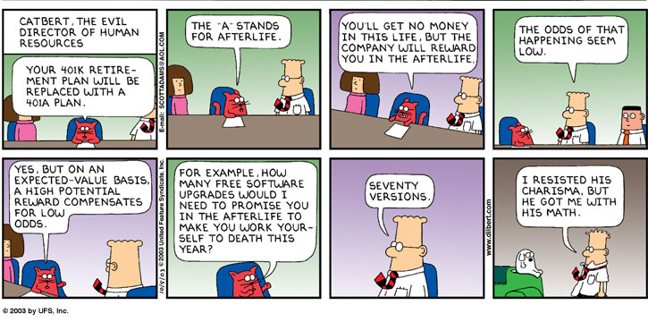
An alternative explanation…

Slide 44
“Immediate gratification”
Rationality assumption
  Economics of privacy: rational agents
  Some exceptions: Acquisti and Varian 2001, Taylor 2003, Acquisti 2004
Acquisti 2004 (ACM EC ’04)
  Time consistent/time inconsistent individuals
  Naïve/sophisticated time inconsistencies (Rabin, O'Donoghue 2000)

Slide 45

A rational agent
Problems
  Incomplete information
  Bounded rationality
  Hyperbolic discounting

Slide 46


Hyperbolic discounting

Slide 47


Survey Time vs. Decision Time

Slide 48
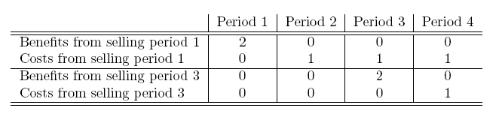
Time consistency vs. time inconsistency

Slide 49
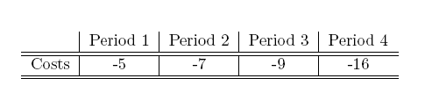
Sophisticated vs. naïve

Slide 50
Consequences
Rationality model not appropriate to describe individual privacy behavior
Time inconsistencies lead to under protection and over release of personal information
Genuinely privacy concerned individuals may end up not protecting their privacy
Also sophisticated users will not protect themselves against risks
Large risks accumulate through small steps
Not knowing the risk is not the issue

Slide 51
Experiment
Acquisti and Grossklags (2004)
  Testing dichotomy for privacy knowledge and hyperbolic discounting
  Berkman Fund
  Pilot test - now

Slide 52
Summary
Why privacy is important for the economy and interesting for economists
The evolution of the economics of privacy
Current issues and open questions
http://www.heinz.cmu.edu/~acquisti/economics-privacy.htm

